Slide 1

RISK AND RESILIENCE BOOTCAMP
5
Notes:
https://www.ncsc.gov.uk/static-assets/documents/PwnedPasswordsTop100k.txt

Slide 2


Slide 3

resilience
This section is a more detailed look at operational resilience along the dimensions of
Business
Technology
Data
Cyber

Slide 4
Operational Resilience
DRI definition
The ability of an organization to anticipate, prepare for, respond to, and adapt to incremental changes and sudden disruptions in order to survive and prosper
ISACA/Basel definition
The organization’s ability to deliver critical operations and services through disruption, safeguarding customers, markets, and the financial system
Traditional business continuity and disaster recovery
Focus on getting systems back online after an incident
Restoring operations to their prior state

Slide 5
Operational Resilience
Operational resilience
Represents a more mature and proactive approach
It assumes that disruptions will happen but the organization’s mission, values, and trust relationships must persist regardless of adverse events
Resilience protects what the organization does (mission), not just what it uses (systems)
Continuity of Mission
The idea that the purpose of the organization must not stop, even when individual systems or functions fail
Operational resilience ensures that critical services, those that define why the organization exists, remain deliverable under duress
For example, a bank’s mission is to maintain financial confidence and liquidity for its customers
Even during a cyberattack or data center failure, deposits, transactions, and access to funds must continue
Designing operations so that core functions are preserved, not just infrastructure restored
For example: alternate processing, manual workarounds, and prioritized resource allocation

Slide 6
Operational Resilience
Continuity of trust
Trust is a critical, often overlooked asset in operational resilience
Customers, partners, regulators must believe the organization can withstand stress and remain reliable
A company that continues to operate transparently and responsibly during crises enhances its reputational capital and goodwill
Repeated outages or inconsistent communication erode confidence and can lead to regulatory scrutiny or customer flight
Maintaining trust requires transparent communication, ethical response behaviors, and robust governance during incidents
Resilience is about preserving confidence as well as preserving capability

Slide 7
Operational Resilience
Continuity of adaptability
Resilience also depends on the adaptability of the organization to rapidly changing work
For example: Cyber attacks, AI technology, pandemics, supply-chain disruptions
Adaptability is learning from disruptions, adjusting processes to be more reliable
Refining preventive and corrective controls, updating SOPs, and evolving architectures is response to disruption
Maturity principle of continuous improvement (discussed later)
Prepare → Respond → Recover → Adapt → Evolve.
High maturity organizations continuously integrate lessons learned into operations, technology, and governance
Operational resilience is not static but must continuously evolve

Slide 8
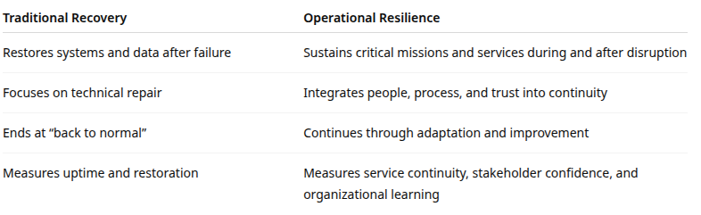
comparison

Slide 9
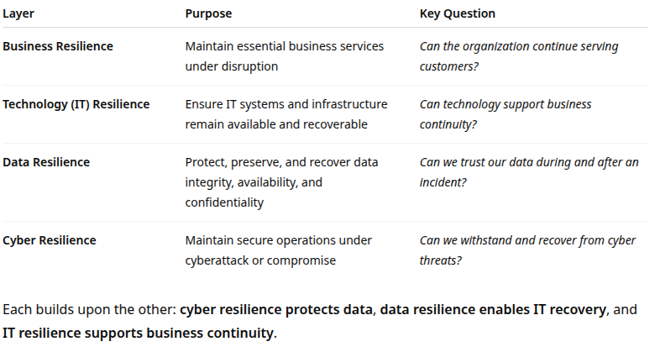
Dimensions

Slide 10
The layers
Business resilience
Capacity of an organization to maintain critical business functions and services during disruption through effective planning, communication, and alternate delivery mechanisms
Core focus areas
Business Impact Analysis (BIA)
Continuity planning and testing
Workforce resilience (cross-training, leadership)
Supplier and third-party continuity
Alternate site and process strategies
Crisis communication and stakeholder management

Slide 11
The layers
Business resilience
Best practices
Define critical functions and their Recovery Time Objectives (RTOs) and Recovery Point Objectives (RPOs)
Develop continuity playbooks for essential processes (payments, trading, claims, logistics)
Regularly exercise continuity plans under different disruption scenarios
Use lessons learned to continually refine plans
Example
A bank’s Business Resilience Plan ensures that payment clearing and customer support continue even if the main data center or call center goes offline
Plan is implemented through using remote access, alternate staffing, and branch-level contingencies

Slide 12
The layers
Technology (IT) resilience
The ability of IT systems, infrastructure, and applications to resist, absorb, recover from, and adapt to disruptions while maintaining essential business services
Core focus areas
Redundant and failover infrastructure
Backup and recovery mechanisms
High-availability and clustering designs
Cloud resilience and multi-region deployments
Testing of failover procedures and RTO/RPO validation
Automation in recovery (Infrastructure as Code, orchestration)

Slide 13
The layers
Technology (IT) resilience
Best practices
Implement disaster recovery (DR) and high-availability architectures based on what is critical to the business
Use chaos engineering to validate system response to failure
Integrate DevOps pipelines for resilience testing during builds
Maintain asset and dependency mapping to identify critical system relationships
Example
A trading platform replicates transaction data across regions and performs automated switchover to a hot site within 30 seconds to maintain compliance with 99.99% up-time requirements

Slide 14
The layers
Data resilience
The ability to preserve and restore data integrity, confidentiality, and availability during and after disruptions
For example: data corruption, accidental or malicious deletion, ransomware events.
Core focus areas
Data backup, replication, and retention
Immutable storage and air-gapped backups
Data classification and prioritization
Encryption and data loss prevention (DLP)
Data governance and lineage tracking
Data validation and integrity testing

Slide 15
The layers
Data resilience
Best practices
Maintain 3-2-1 backup strategy (3 copies, 2 media, 1 off-site)
Test restore processes regularly; backups are only as good as verified recoveries
Classify data based on criticality; for example, Tier 1 for regulatory and customer data
Use immutable snapshots and continuous replication for critical data sets
Integrate data recovery drills into continuity and Cyber incident tests
Example
A hospital’s EHR (Electronic Health Records) system uses daily encrypted backups and maintains redundant copies in two cloud regions
Periodic test restores validate recovery times within RTOs

Slide 16
The layers
Cyber resilience
Cyber resilience combines information security and continuity disciplines to ensure the organization can withstand, detect, respond to, and recover from cyber incidents without severe impact
Core focus areas
Threat detection and response (SIEM, SOC, EDR)
Identity and access management (MFA, least privilege)
Network segmentation and zero trust architecture
Security patching and vulnerability management
Incident response and recovery planning
Integration with business continuity and crisis management

Slide 17
The layers
Cyber resilience
Best practices
Implement Defense-in-Depth architecture and Zero Trust principles
Establish Incident Response SOPs with defined roles and escalation paths
Use cyber incident simulations (tabletop exercises) involving IT, legal, and executive teams
Ensure backup systems are logically separated to prevent ransomware encryption spread
Apply DRI’s lifecycle approach: prepare → detect → respond → recover → adapt
Example
A major retailer withstands a ransomware attack because its cyber resilience plan isolates infected systems, activates clean backups, and restores operations within 6 hours, all coordinated via its incident response SOP

Slide 18
Definitions
SIEM: Security Information and Event Management
SIEM is a technology platform that collects, correlates, and analyzes security-related data from across an organization’s IT environment to investigate, and respond to security incidents
Includes servers, firewalls, network devices, and applications
Purpose
To provide centralized visibility into security events and potential threats
To correlate patterns across multiple systems that may indicate attacks or policy violations
To support real-time alerting, incident response, and compliance reporting
Key capabilities
Log aggregation: Collects logs from across the enterprise
Event correlation: Connects multiple indicators to detect complex threats
Alerting and dashboards: Real-time monitoring for suspicious activity
Forensics and reporting: Provides evidence for audits and investigations

Slide 19
Definitions
EDR: Endpoint Detection and Response
Cybersecurity technology that monitors and analyzes endpoint activities to detect, investigate, and respond to suspicious behavior or malware in real time
For example: laptops, servers, mobile devices, IoT
Purpose
To provide detailed visibility into endpoint behavior and attack chains
To support rapid containment and remediation actions
For example: isolate device, kill process
Key capabilities
Real-time monitoring: Continuous tracking of process execution, registry changes, network connections, etc.
Behavioral analytics: Detect anomalies or suspicious activity patterns
Automated response: Quarantine devices or block malicious actions instantly
Forensics: Provide timeline and evidence for post-incident analysis

Slide 20
Definitions
Chaos engineering
Deliberately injecting controlled failures or disruptions into systems to test their resilience, reliability, and ability to recover under real-world conditions
Based on the idea that the best way to build fully resilient systems is to experiment with failure before it happens in production, identify weaknesses, and fix them proactively
Rationale
Modern IT systems are complex
For example: especially those running in the cloud, with microservices, containers, and distributed architectures
Even small component failures can cascade into large-scale outages if the system isn’t designed for fault tolerance
Chaos engineering goals
Reveals hidden dependencies and failure modes
Validates assumptions about redundancy, failover, and recovery mechanisms
Improves operational resilience by testing how people, processes, and technology respond to stress
Shift from preventing failure to preparing for it by experiencing it

Slide 21
Definitions
Chaos engineering
Chaos engineering is structured and scientific, not creating random damage
Start from a steady state
Define normal system behavior
For example: latency, throughput, error rates
Form a hypothesis
Example: “If one database node fails, the application will continue serving users via the replica”
Introduce controlled disruption
Simulate real-world faults such as network latency, instance crashes, or service outages
Observe and measure
Monitor system metrics and user experience for deviation from the steady state
Learn and improve
Identify weaknesses, fix them, and re-test until the system performs predictably under stress

Slide 22
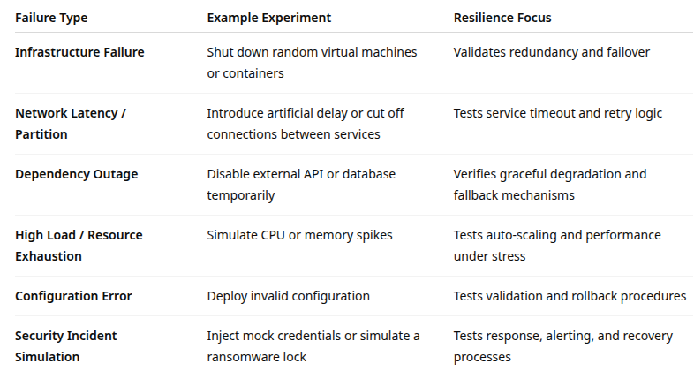
Chaos examples

Slide 23
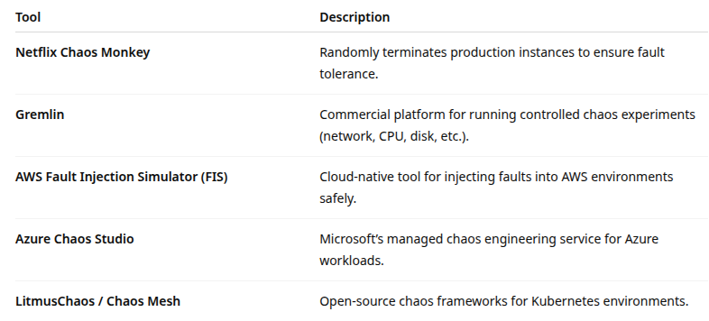
Chaos tools

Slide 24
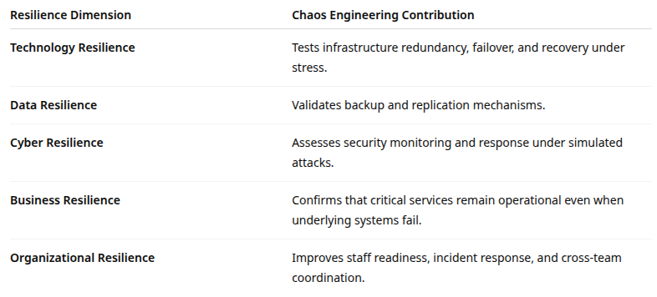
Chaos resilience support

Slide 25
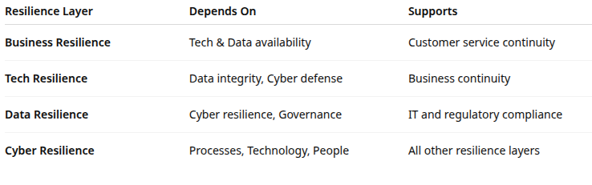
Integration and Interdependence

Slide 26
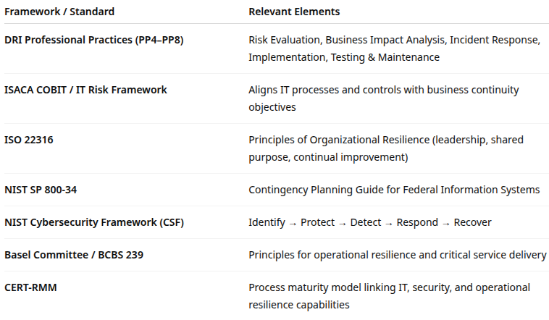
Framework Alignment

Slide 27

Q&A and open discussion
Notes:
Now is the time to engage in an interactive Q&A session where you can ask questions, share insights, and clarify any doubts about the topics we have covered so far.
This open discussion is designed to ensure that every participant has the opportunity to voice their thoughts and learn from the collective experience of the group.
Your questions and comments are valuable as they help us identify areas that may need further explanation and enable us to tailor future sessions to your needs.
We encourage you to speak up and contribute to the dialogue, as this interaction is one of the key components of our interactive learning approach.
As the session progresses, take note of any questions or ideas that you would like to revisit, and feel free to share your perspectives with the class.

